Slide 1
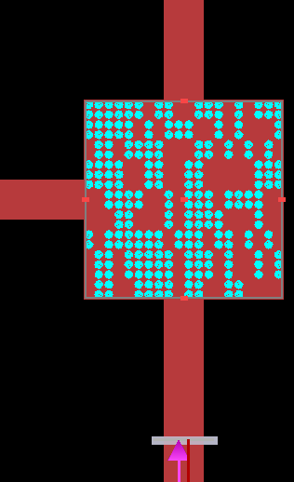
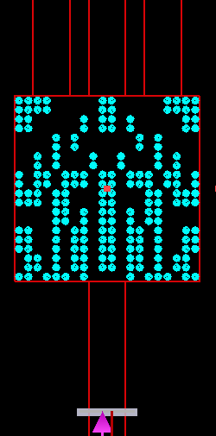
Last Week
This Week
Cross Splitter
1-Input 3-Output Splitter
1-Input 3-Output Splitter
Network algorithm

Slide 2
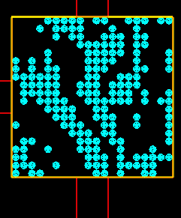
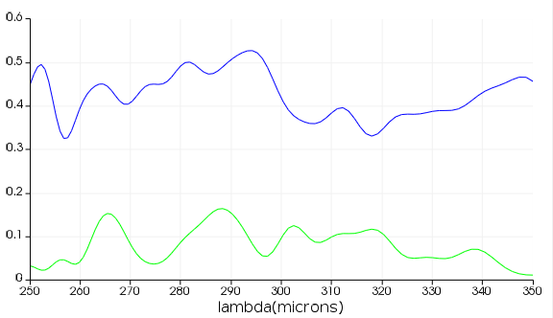
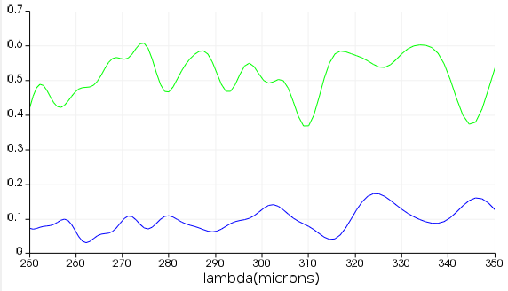
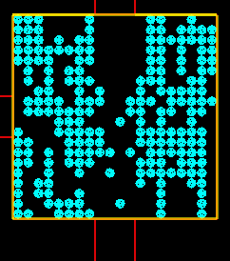
Cross Power Splitter – Result
Data
T₁ max = 0.3
T₂ max = 0.5
FOM = T₁
T₂
T₁
T₁
T₂
Input
FOM = norm(T₁) +norm( T₂)
T₂
T₂
T₁
T₁
Input

Slide 3
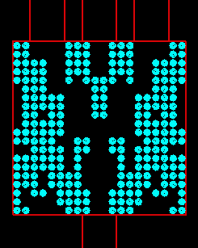
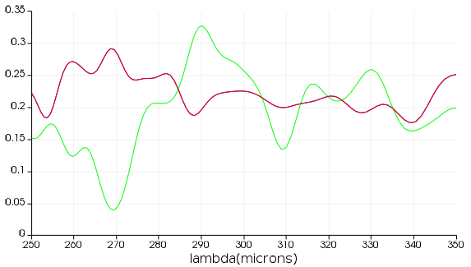
1-Input 3-Output Splitter – Result
FOM = T₁+T₂+T₃
T₁
T₂
T₃
T_{1,3}
T₂
Input

Slide 4
2D Power Splitter – Algorithm
Without Nerual Network
ARLA (Additive Reinforcement Learning Algorithm)
=> 현재 사용 중인 알고리즘
With Neural Network
FCDNN (Fully Connected Deep Neural Network)
ResNet (Residual Network)
DenseNet (Dense Network)
=> 구현 중

Slide 5
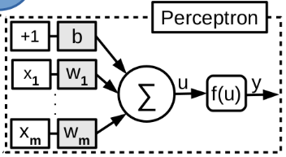
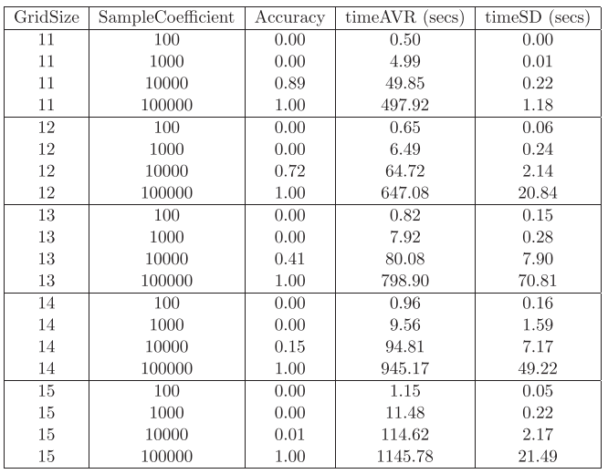
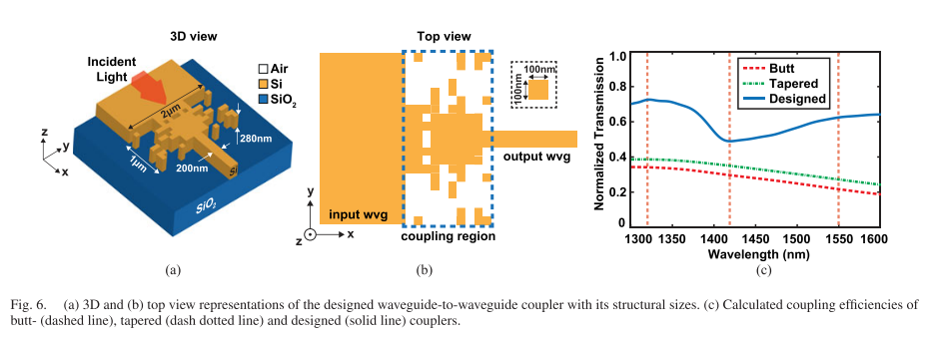
Algorithm without Neural Network
Without Nerual Network
ARLA (Additive Reinforcement Learning Algorithm)
Training
Data
Result
Structure
Algorithm
Algorithm ref. : Çağrı Latifoğlu, “Binary Matrix Guessing Problem,” arXiv:1701.06167 [cs.AI], 2018
Application ref. : Mirbek Turduev et al. “Ultracompact Photonic Structure Design for Strong Light Confinement and Coupling Into Nanowaveguide,” Journal of Lightwave Technology, 2018

Slide 6
Additive Reinforcement Learning Algorithm (ARLA) Example
0 | 1 | 1 | 0 | 1
Sequences
scores
Sequences * scores
1 | 0 | 1 | 0 | 1
5-2=3
3 | 0 | 3 | 0 | 3
0 | 1 | 0 | 1 | 0
5-3=2
Sequence * score
0 | 2 | 0 | 2 | 0
Sum
0 | 0 | 1 | 0 | 0
5-2=3
0 | 0 | 3 | 0 | 0
0 | 1 | 1 | 1 | 1
5-1=4
0 | 4 | 4 | 4 | 4
Substract min.(=3)
3 | 6 | 10 | 6 | 7
0 | 3 | 7 | 3 | 4
Average = 3.4
e_{i}> average: 1
e_{i}< average: 0
Result sequence
score
0 | 0 | 1 | 0 | 1
5-1=4

Slide 7
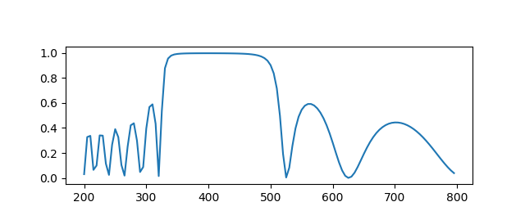
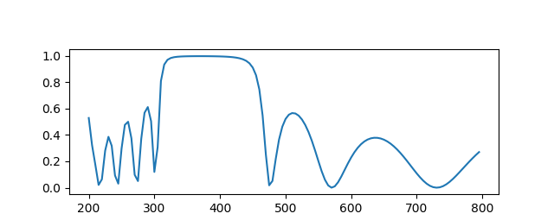
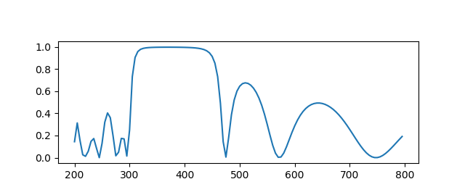



DBR(ARLA) - Result
N_{pixel}: 100, dx: 5 nm, n_{h}: 2.681 (TiO₂), n_{l}: 1.470 (SiO₂)
$$L=N_{pixel}∗dx$$
Theory
R_{out}
R_{in}
R_{out}
$$dx$$
$$i$$
Reflectivity
…
Wavelength [nm]
ARLA_R_{in} / R_{out}
ARLA_R_{in}*(1-R_{out})
 | score | FWHM | Thickness (nm)
Theory [R_{in} / R_{out}] | 2.167 | 195 | 37, 68, 37, 68, 37, 68, 37, 68, 37, 68, 37
Theory [R_{in}*(1-R_{out})] | 0.538
R_{in} / R_{out} | 2.280 | 165 | 5, 45, 50, 40, 45, 40, 50, 40, 45, 40, 50, 45
R_{in}*(1-R_{out}) | 0.546 | 165 | 10, 40, 45, 45, 45, 40, 50, 40, 45, 45, 45, 40

Slide 8
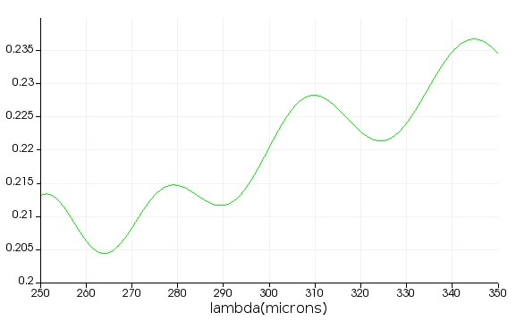
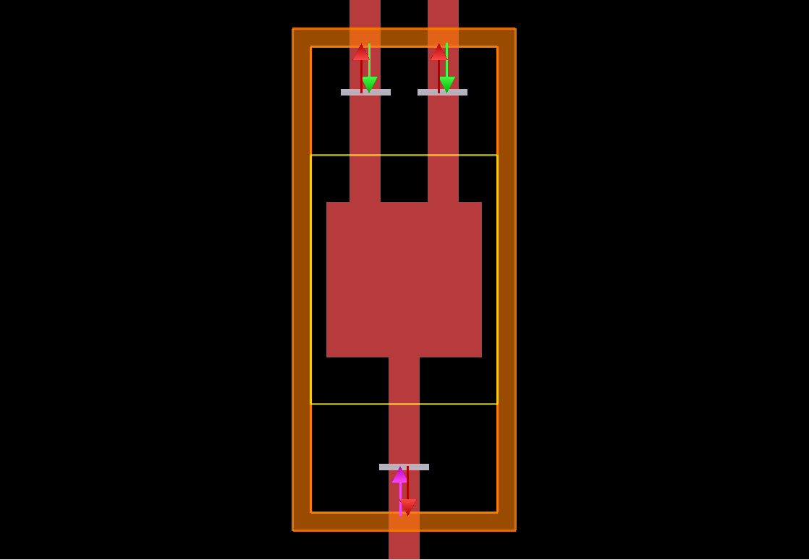
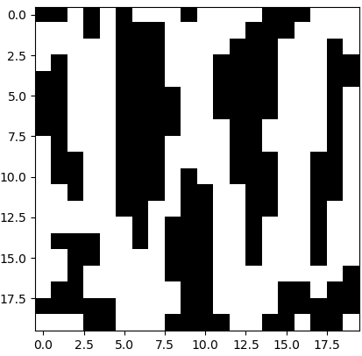
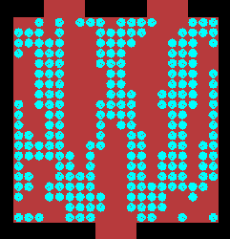
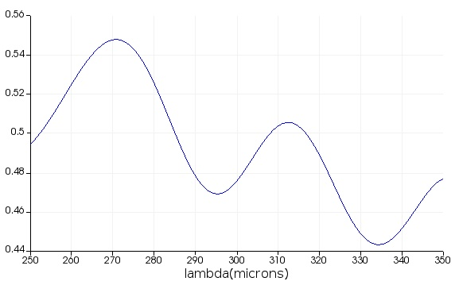
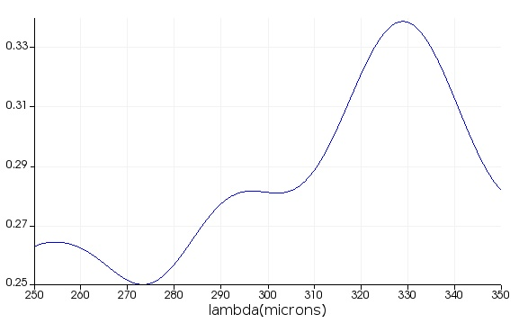
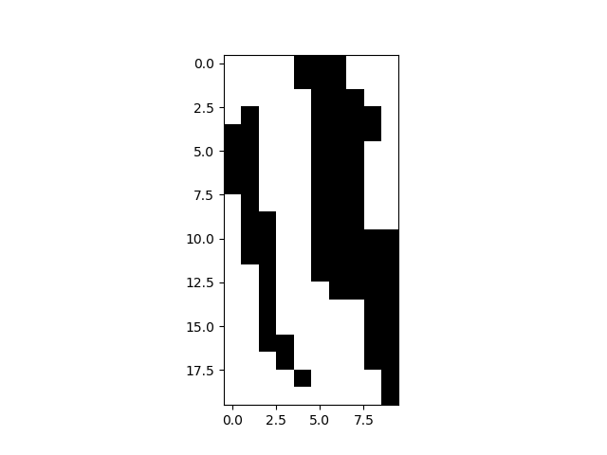
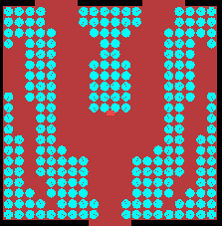
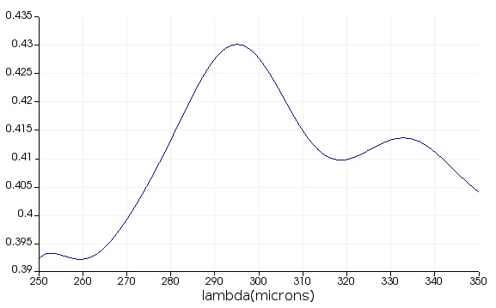
2D Power Splitter(ARLA) – Result
random
T₁
T₂
T₁ ~0.5
T₂ ~ 0.3
symmetry
T₁
T₂
T₁ ~0.41
T₂ ~0.41

Slide 9
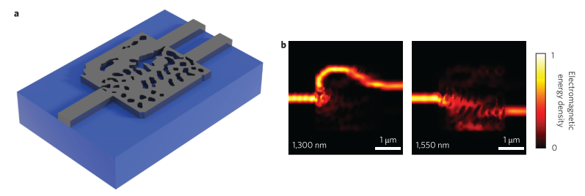

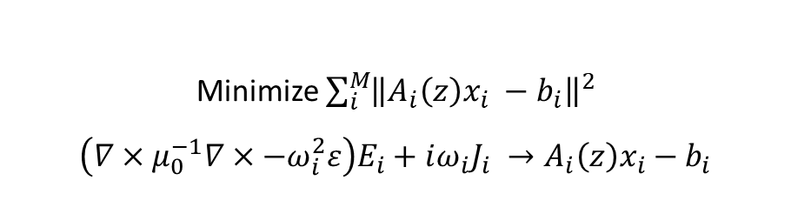
Algorithm with Neural Network
Inverse design
Inverse design
structure
$$f\left(x\right)$$
spectrum
Ex. T-matrix, FDTD
Minimize $\sum_{i}^{M}{{\left\|A_{i}\left(z\right)x_{i} −b_{i}\right\|}^{2}}$
$$\left(∇×μ_{0}^{−1}∇×−ω_{i}^{2}ε\right)E_{i}+iω_{i}J_{i} →A_{i}\left(z\right)x_{i}−b_{i}$$
ref. : A. Piggott, J. Lu, Lagoudakis et al. “Inverse design and demonstration of a compact and broadband on-chip wavelength demultiplexer," Nature Photonics, 2015

Slide 10
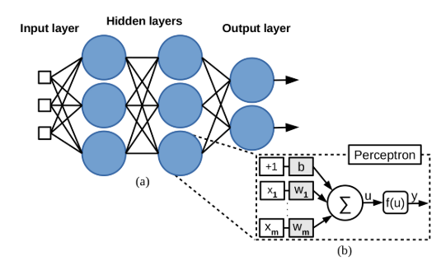

Algorithm with Neural Network
With Neural Network
FCDNN (Fully Connected Deep Neural Network)
ResNet (Residual Network)
DenseNet (Dense Network)
$$f\left(x\right)=g\left(x\right)+n(x)$$
FDTD
Simulation
Neural
Network
error
Forward design
Inverse design
Initial
structure
Neural
Network
Result
Structure
Optimizer
Iteration
FCDNN ref.1 : A. da Silva Ferreira et al. "Computing Optical Properties of Photonic Crystals by Using Multilayer Perceptron and Extreme Learning Machine," Journal of Lightwave Technology, 2018
FCDNN ref.2 : Dianjing Liu et al. “Training Deep Neural Networks for the Inverse Design of Nanophotonics Structures," ACS Photonics, 2018
ResNet ref. : Mohammd H. Tahersima et al. “Deep Neural Network Inverse Design of Integrated Photonic Power Splitters,” Scientific Reports, 2019

Slide 11
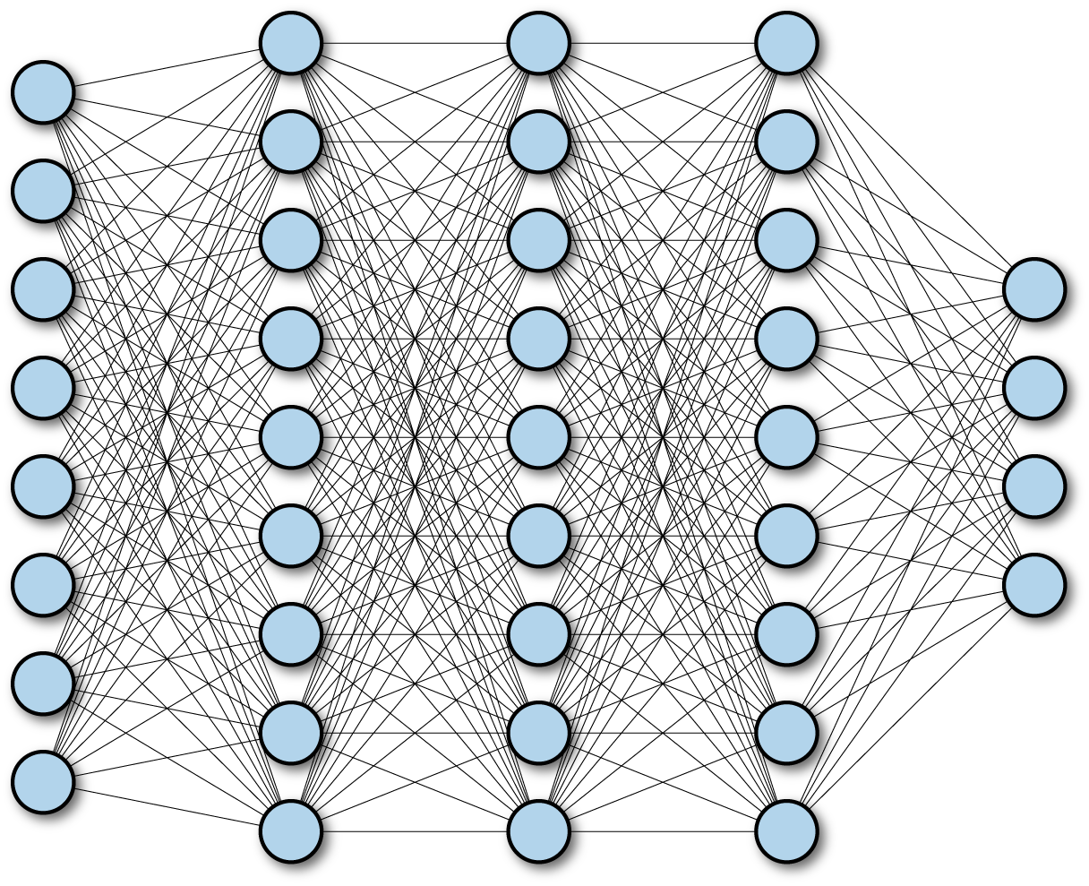
Neural Netowrk
FCDNN (Fully Connected Deep Neural Network)
Layer
Input
Output
ResNet (Residual Network)
Layer
1
Layer
2
Layer
3
Layer
4
Input
+
+
Output
DenseNet
Dense Block
Layer
1
Layer
2
Layer
3
Layer
4
Input
[+]
[+]
[+]
[+]
Output

Slide 12
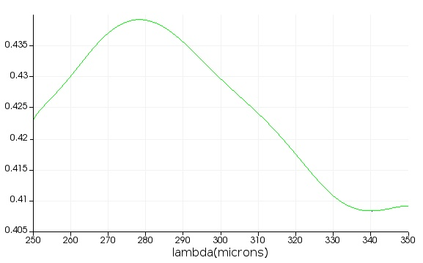
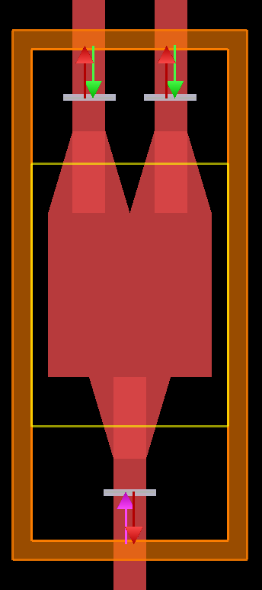
2D Power Splitter – FDTD Setting
Output 1&2
(b)-1
(a)-1
(a)-2
~ 0.4
(b)-2
~ 0.2
Simulation region: 250 ~ 350 um
Waveguide thickness: 100 um
Square: 500 um x 500 um
Taper connection: 250 um
Holes: 20x20 with a radius of 9 um

